Slide 1
Annual Conference 2019
Anthony J. Kissik
Alabama Junior Shooting Chairman
AJKissik@Yahoo.com, 334.202.2812

Slide 2
Alabama Junior Shooting Program
American Legion Junior Shooting Sports Program…
Teaches rifle safety, proper firearm handling procedures, competition participation
Youth participate and compete in an Olympic skill sport
Foster healthy competition and good sportsmanship
Shooters are educated/trained to use a .177 air rifle
http://www.legion.org/shooting

Slide 3
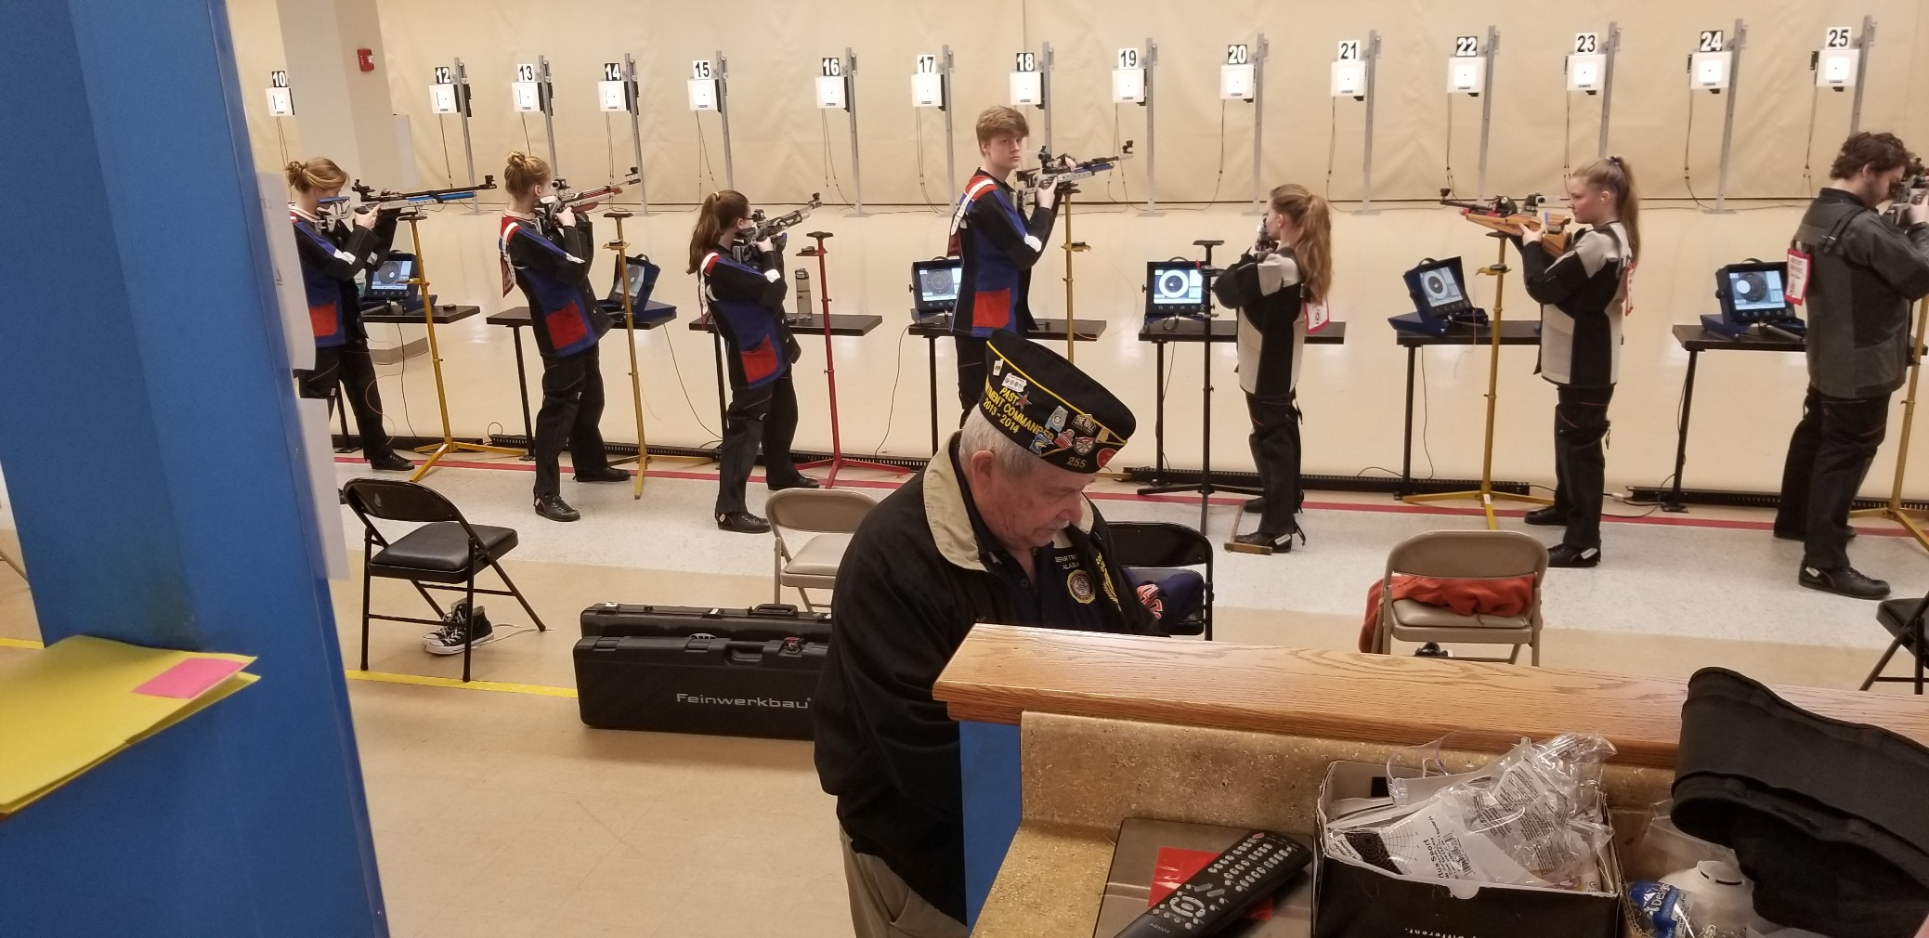
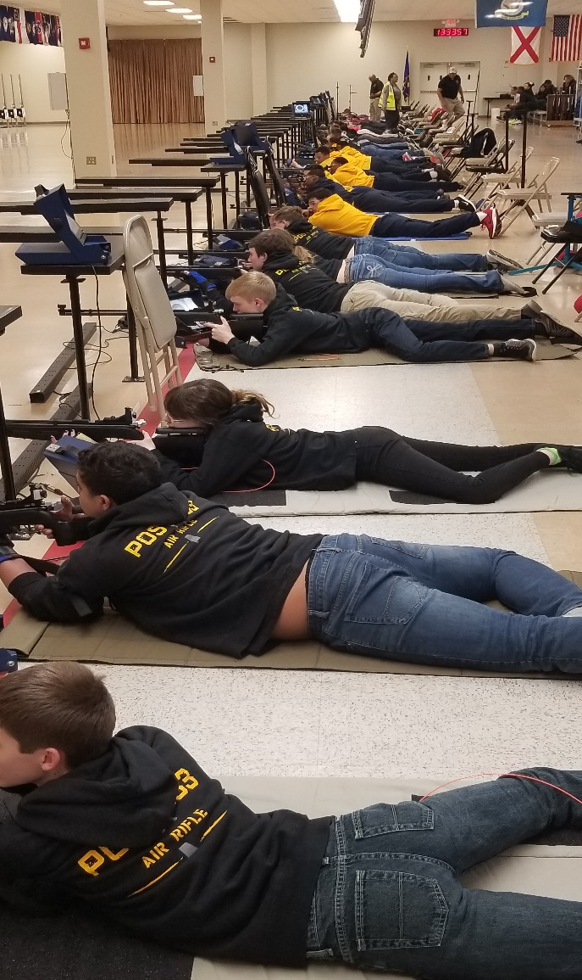
Alabama Junior Shooting Program

Slide 4
Alabama Junior Shooting Program
Sponsoring a Junior Rifle Team…
Allows the team to participate in the American Legion National 3PAR Air Rifle Tournament and the Alabama American Legion Commanders Cup
The Junior Shooting Team should show their appreciation to the Post for the opportunity to compete in the National Tournament and Commanders Cup
A common practice for Posts sponsoring shooting teams is for the Post to purchase t-shirts and pay for the National Tournament (~$12.50/shooter) and/or the Commanders Cup (~$25/shooter)

Slide 5
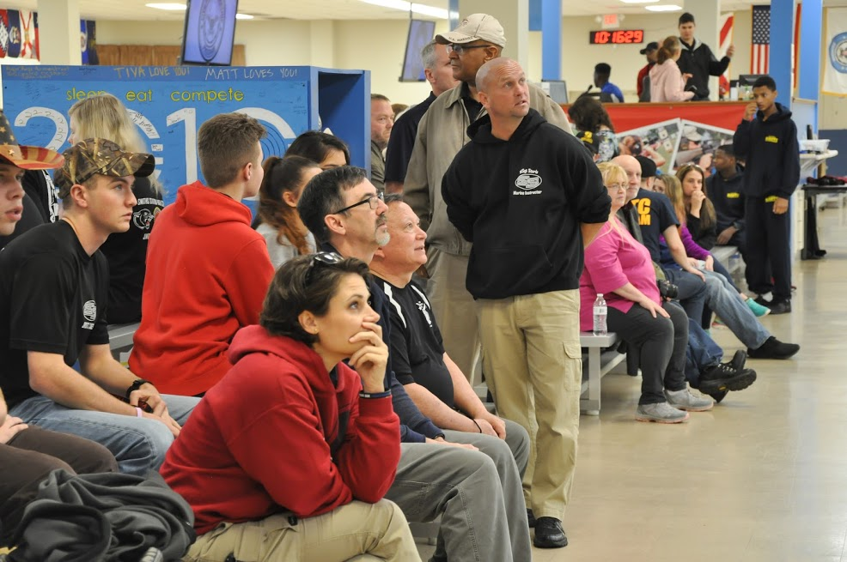
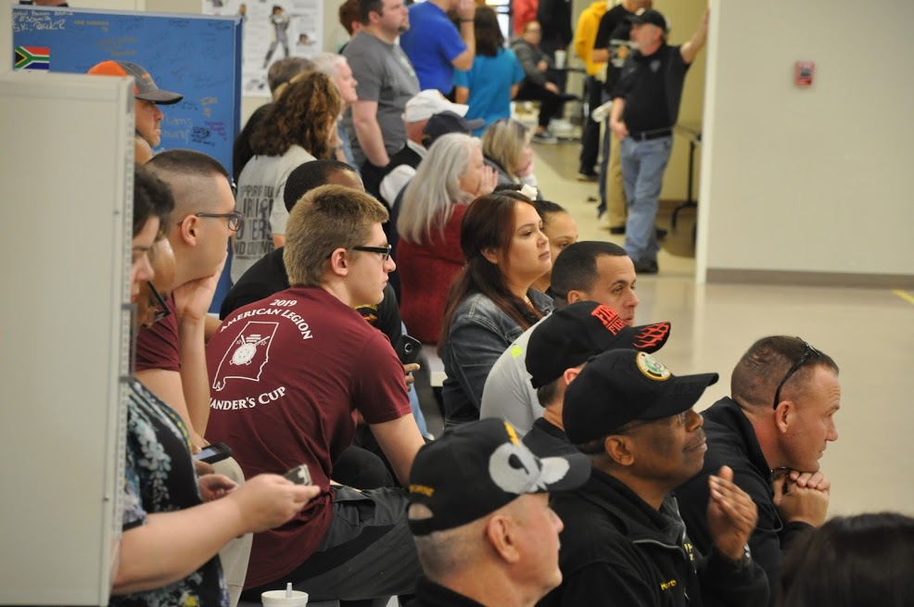
Alabama Junior Shooting Program

Slide 6
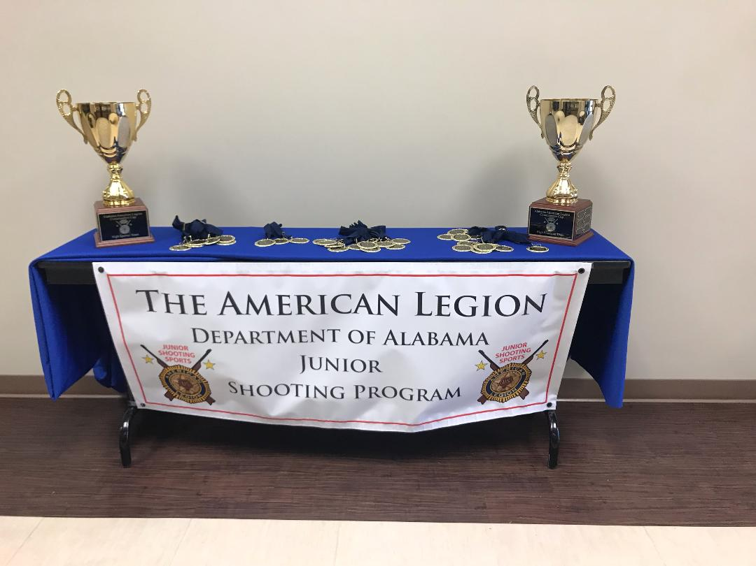
Alabama Junior Shooting Program
Alabama Commanders Cup
* March 7, 2020 (1st Saturday)
* CMP South Range, Anniston, AL
* American Legion Affiliated Teams
* Post Active Participation

Slide 7
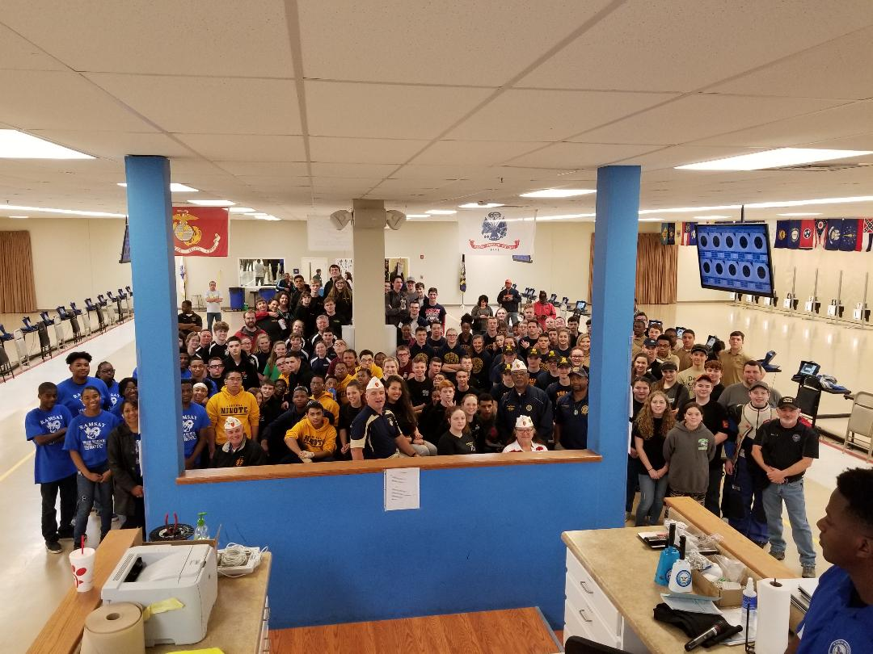
2019 Commanders Cup 3 Position Air Rifle

Slide 8
2019 Commanders Cup 3 Position Air Rifle
Affiliated Teams Who Participated
Cullman Area Career Center 133 Stanhope
Calhoun Hawkeyes Phenix City H.S.
Rehobeth H.S Russell County H.S.
SCSSA Greenville H.S.
Smith Station H. S. Ramsay H. S
Fort Payne H.S. Carroll H. S.
Sparkman H.S. MCGC
Shades Valley H.S.*
Affiliated Teams Who Did Not Participate
Dothan H.S. Satsuma H.S.
Enterprise H.S. Williamson H.S.
Daleville H.S. B.C. Rains H.S.
Buckhorn H. S. LeFlore H.S.
Hazel Green H.S.
How Does the Commanders Cup Happen
Jr. Shooting Budget
Commanders Cup is a Fund Raiser
2019 - $1800
2018 - $825
2017 even
Concession Stand (Post 5)
Merchandise Auction
Friends NRA Banquet
Post Active Participation

Slide 9
2019 Commanders Cup 3 Position Air Rifle
 | 2019 Commanders Cup | 2018 Commanders Cup | 2017 Commanders Cup
Total Athletes | 113 | 81 | 30
Precision | 21 | 23 | 4
Sporter | 92 | 58 | 26
Teams | 14 | 10 | 4
Posts | 12 | 9 | 3
3 PAR Athletes | 113 | 81 | 30
60 Shot Precision | 21 | * | *
60 Shot Sporter | 9 | * | *
60 Shot Sporter Prone | 15 | * | *

Slide 10
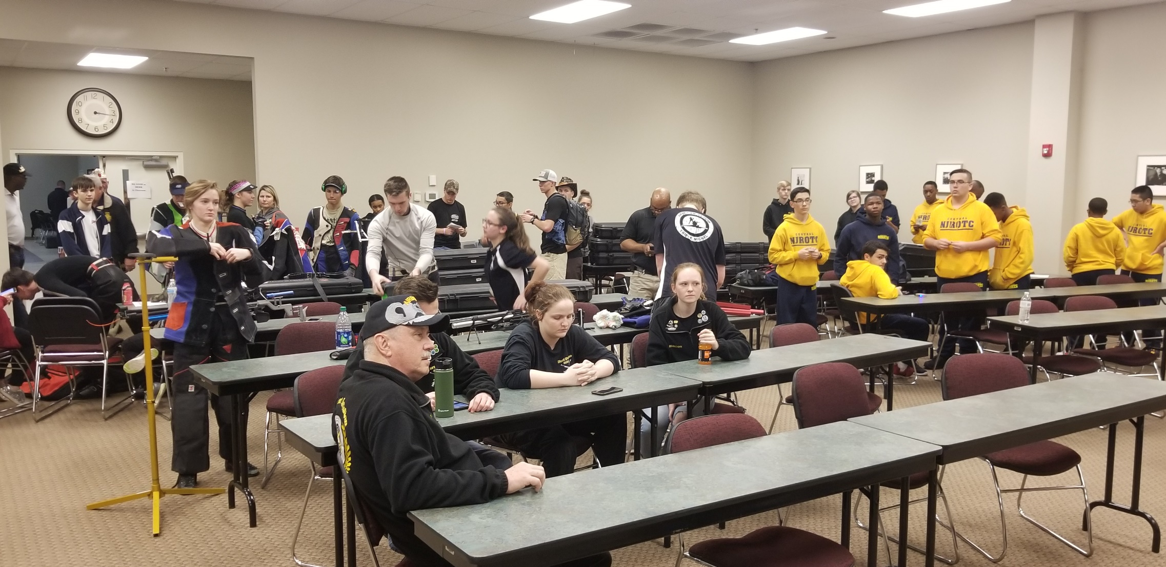
2019 Commanders Cup 3 Position Air Rifle

Slide 11
2019 Commanders Cup 3 Position Air Rifle
60 Shot Standing Precision
1st – Andrew Duryea – Post 5 – Calhoun County Hawkeyes
2nd – Clark McWhorter – Post 5 – Calhoun County Hawkeyes
3rd – Maggie Vonderau – Post 555 – Shelby County Shooting Sports Association
60 Shot Standing Sporter
1st – Kristen Fowler – Post 30 - Fort Payne High School JROTC
2nd – Devin Thomason – Post 30 - Fort Payne High School JROTC
3rd – Ibet Perez – Post 30 - Fort Payne High School JROTC
60 Shot Sporter Prone
1st – incorrect CMP
2nd – Carley Seabrooke – Post 555 – Shelby County Shooting Sport Association
3rd – Brandon Edwards – Post 133 – 133 Stanhope Rifle Team

Slide 12
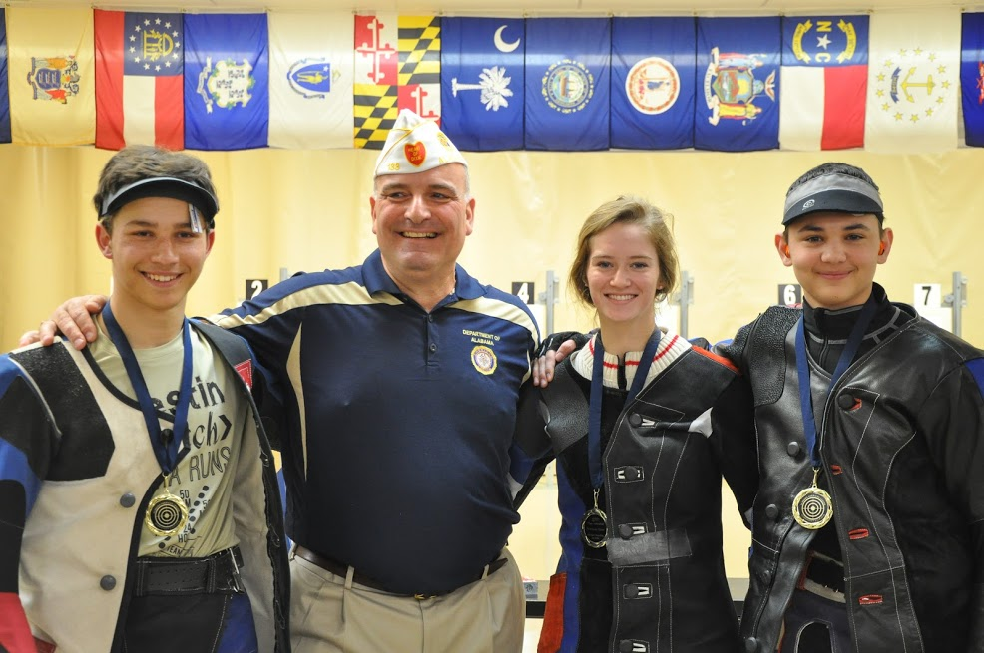
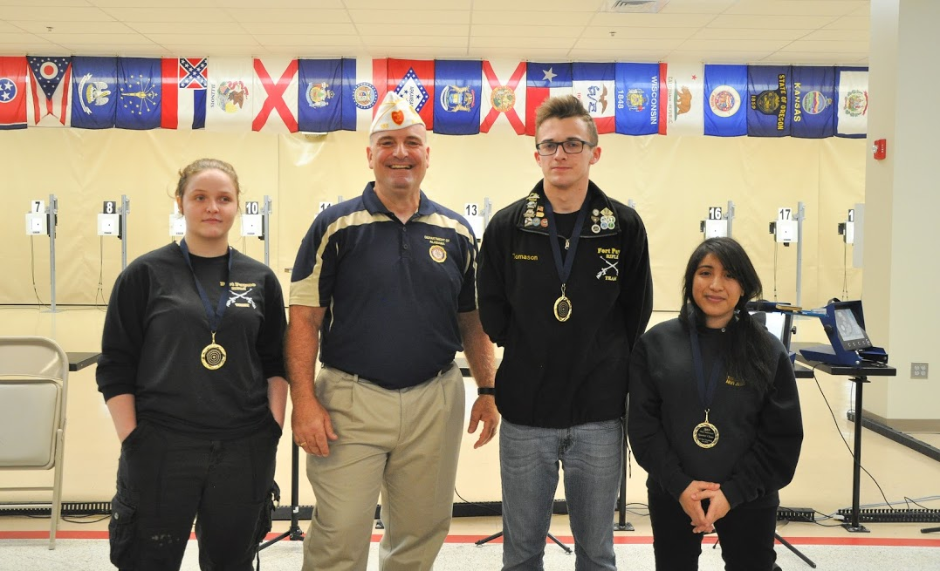
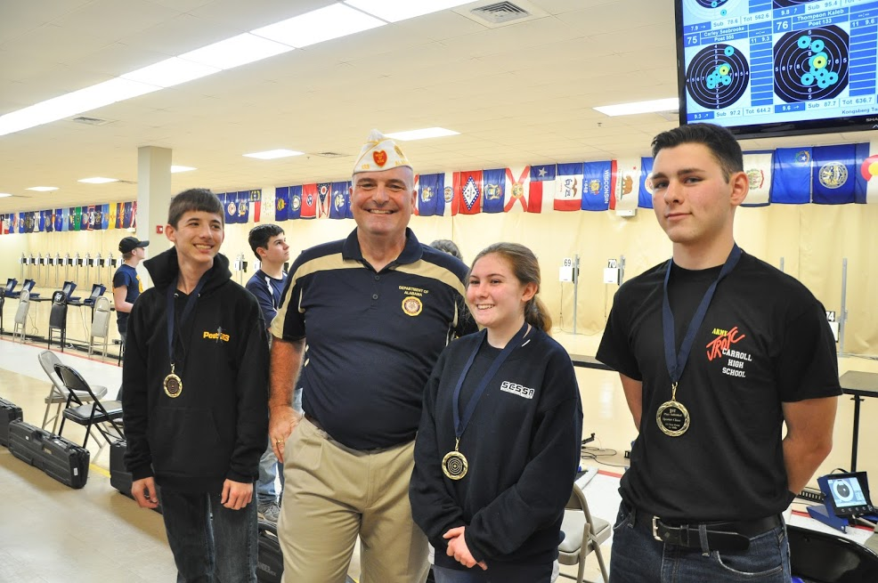

Slide 13
2019 Commanders Cup 3 Position Air Rifle
Team - Sporter
1st - Post 30 – Fort Payne High School JROTC
2nd - Post 133 – 133 Stanhope Rifle Team
3rd - Post 5 – Calhoun County Hawkeyes
Team - Precision
1st - Post 5 – Calhoun County Hawkeyes
2nd - Post 555 - Shelby County Shooting Sports Association Team 1
3rd - Post 255 – Magic City Gun Club
3 PAR Individual - Sporter
1st - Kristen Fowler - Post 30 – Fort Payne JROTC
2nd - Devin Thomason - Post 30 - Fort Payne JROTC
3rd - Jade Robison - Post 30 – Fort Payne JROTC
3 PAR Individual - Precision
1st - Clark McWhorter - Post 5 – Calhoun County Hawkeyes
2nd - Maggie Vonderau - Post 555 – Shelby County Shooting Sports Association
3rd - Cady Thomas – Post 255 – Magic City Gun Club

Slide 14
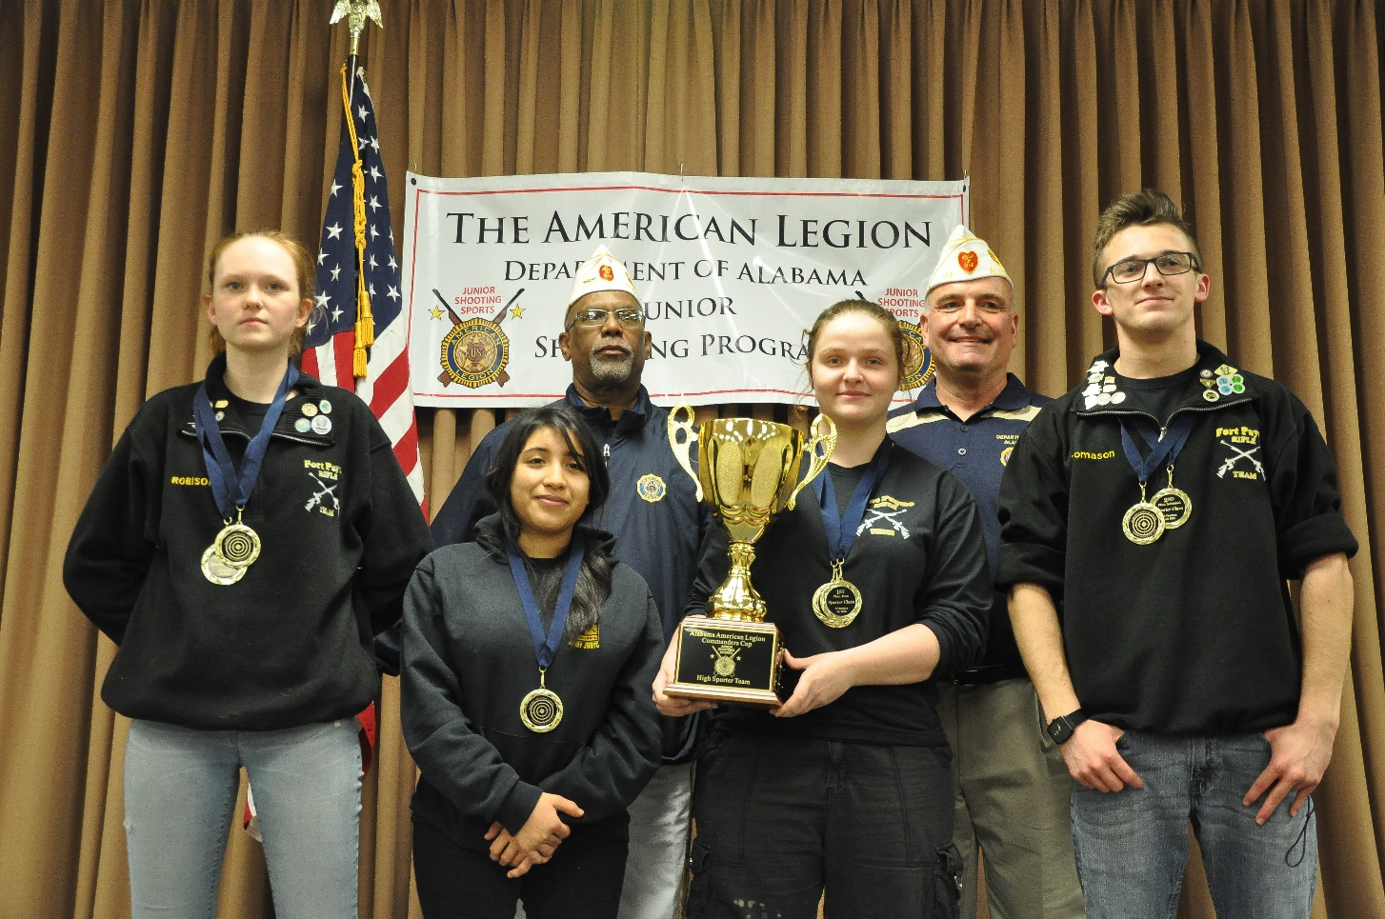
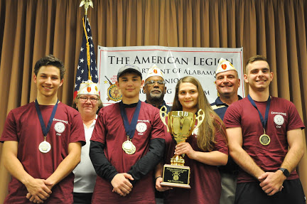
2019 Commanders Cup 3 Position Air Rifle

Slide 15
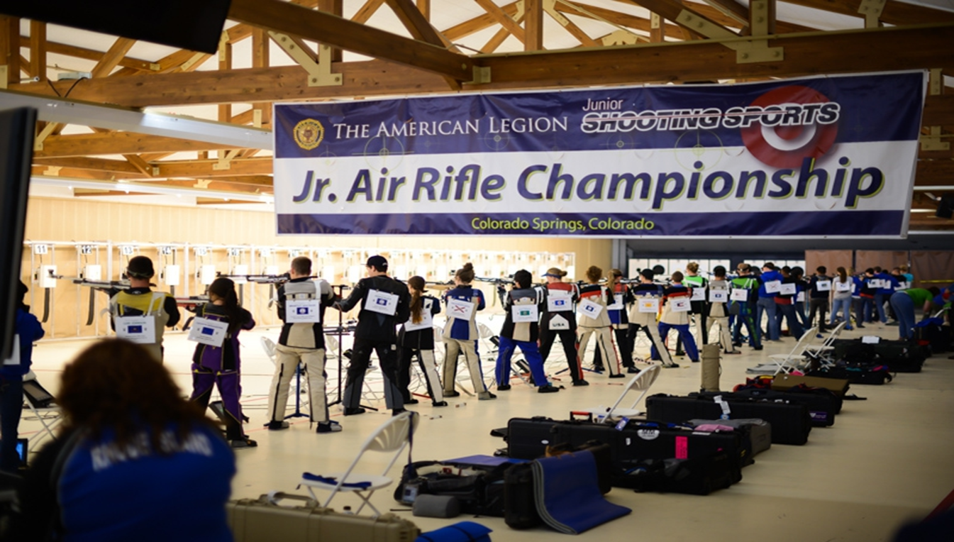
2019 American Legion National Tournament
National Tournament
November – January
Prone, Standing, Kneeling @10 meters
2 Postal Matches – top 15 shooters
Finals - Colorado Spring, CO
$5,000/$1,500 Scholarship

Slide 16
2019 American Legion National Tournament
2016
1 Team/4 Individuals
2019
13 Teams/64 Individuals

Slide 17
2019 American Legion National Tournament
Alabama Precision – Team Results
Post Team Name Alabama (6) National (84)
5 Calhoun Hawkeyes 1 9
555 SCSSA 2 20
255 MCGC 3 29
73 Enterprise High School 4 37
555 SCSSA 5 45
73 Enterprise High School 6 59

Slide 18
2019 American Legion National Tournament
Alabama Sporter Teams – How They Finished
Post Team Name Alabama (7) National (159)
73 Enterprise High School 1 21
30 Fort Payne High School 2 23
133 133 Stanhope 3 37
73 Enterprise High School 4 52
229 Sparkman Varsity 5 54
5 Calhoun Hawkeyes 6 63
555 SCSSA 7 119

Slide 19
2019 American Legion National Tournament
Alabama Precision Individual – How They Finished
Athlete Post Team Name Alabama (31) National (428)
Dawson Kissik 5 Calhoun Hawkeyes 1 14*
Andrew Duryea 5 Calhoun Hawkeyes 2 20*
Cady Thomas 255 MCGC 3 57
Garrett Boggan 255 MCGC 4 78
Emily Buck 555 SCSSA 5 81

Slide 20
2019 American Legion National Tournament
Alabama Sporter Individual – How They Finished
Athlete Post Team Name Alabama (33) National (770)
Kristen Fowler 30 Fort Payne High School 1 5*
Devon Thomas 30 Fort Payne High School 2 41
Zaidee Lerma 73 Enterprise High School 3 75
Trinitee Nez 73 Enterprise High School 4 85
Morgan Werhan 73 Enterprise High School 5 92

Slide 21
2019 American Legion National Tournament
National Championship
July 23 – 28
Olympic Training Center
Colorado Springs, CO
National Headquarters
Provides Transportation, Hotels, Meals, Incidentals Stipend

Slide 22
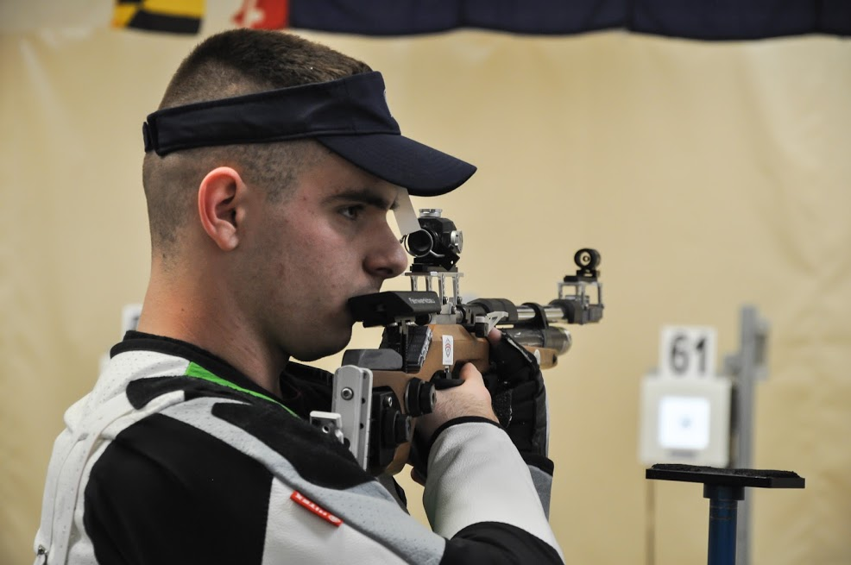
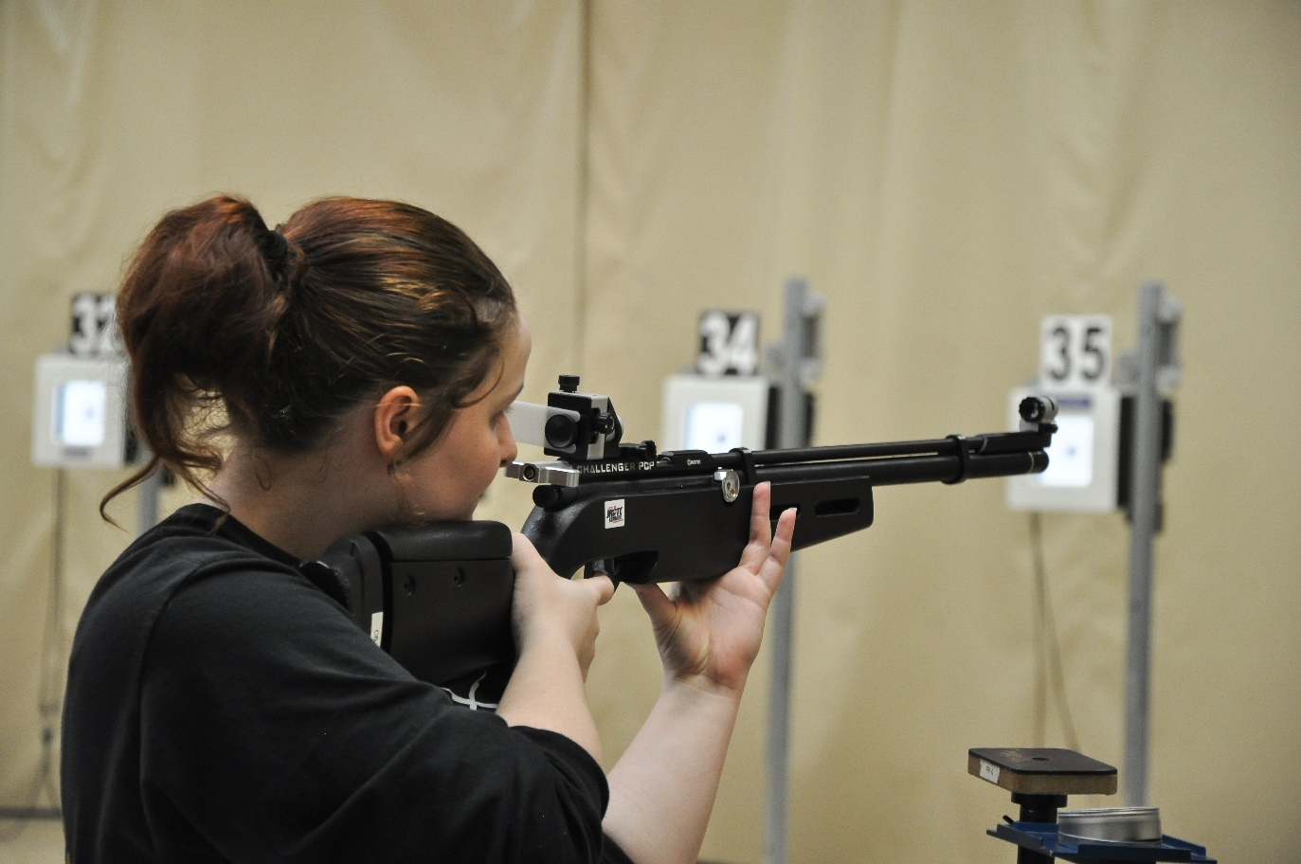
2019 American Legion National Tournament
Dawson Kissik
Kristen Fowler

Slide 23
Alabama Junior Shooting Program
First Shot March 2016
Post 82
Post 88
Post 133
Post 135 (3)
Post 229
Post 237
Post 255 (2)
Post 555
Post 911
Post 4
Post 5
Post 12 (2)
Post 24
Post 30
Post 49
Post 73 (2)
Post 76 (3)
Insert First P3 Shot
Who is Next??
17 Posts
23 Junior Shooting Team

Slide 24
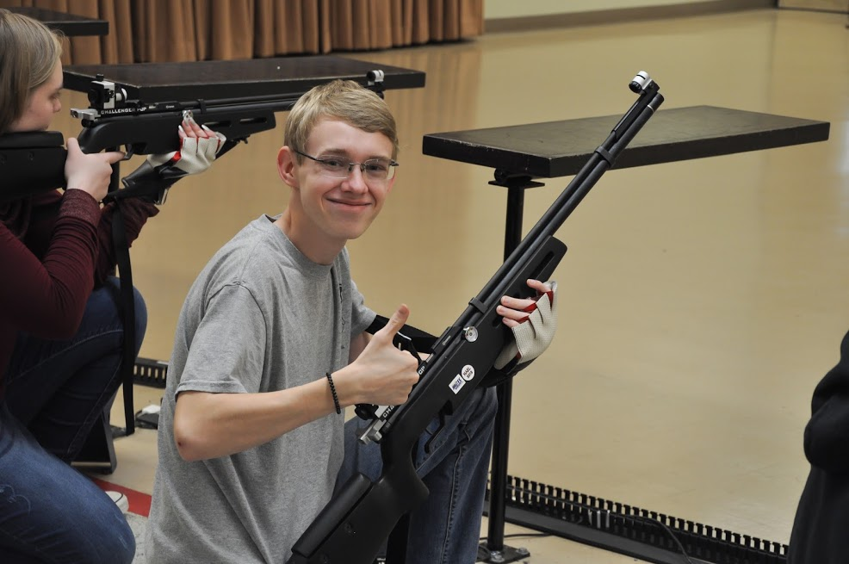
Alabama Junior Shooting Program
Annual Conference 2019
Anthony J. Kissik
Alabama Junior Marksmanship Chairman
AJKissik@Yahoo.com, 334.202.2812

